Slide 1
Installing resources for native-compiled npm modules (e.g. npm mongodb module)
Some modules require native compilation (they must be compiled once downloaded)
Typcally this involves having a C++ compiler, Python 2.7.x compiler and the npm global utility node-gyp.
Here I go through the steps I used to set up my laptop to be able to use the lastest npm mongodb driver by having the required resources to complile the code.

Slide 2
Components needed
For install on Windows 8.1 machine.
Visual Studio 2013
Microsoft Windows 7 SDK
Python 2.7.x
npm node-gyp

Slide 3
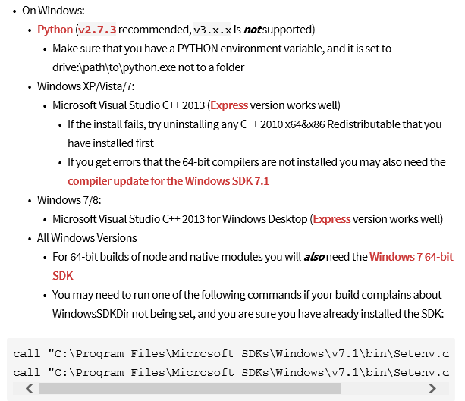
Components needed npm node-gyp modules at: https://www.npmjs.com/package/node-gyp

Slide 4
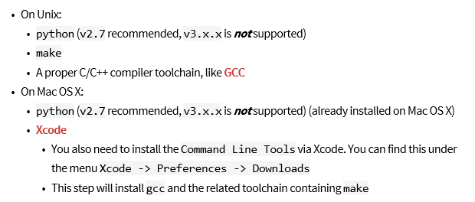
For linux, and Mac (not used here as we are doing Windows 8.1 example)

Slide 5
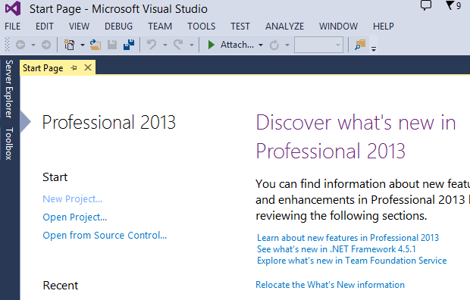
Installing Microsoft Visual Studio 2013.
Software obtained from MSDN (Dreamspark) downloads available to all student.
Product has lic key which is required after 30 day trial period expires.

Slide 6
Installing Windows 7 SDK on Windows 8.1 machine
Notes
Obtained from: http://www.microsoft.com/en-us/download/details.aspx?id=8279
I had to remove Visual Studio 2010 redistributatble using control panel in order to be able to install Windows 7 SDK.
(Presumably because the version I had was more recent than the one it was trying to install)
Alternatively, one should be able to "uncheck" the installation of the VS 2010 redistributabe.

Slide 7
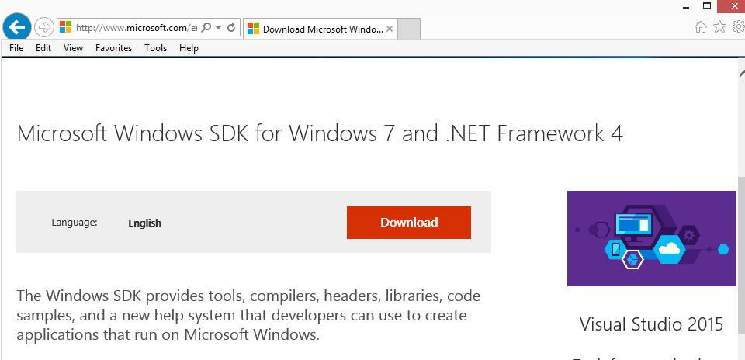
Installing Windows 7 SDK on Windows 8.1
Obtained from: http://www.microsoft.com/en-us/download/details.aspx?id=8279
I had to remove Visual Studio 2010 redistributable using control panel in order to be able to install Windows 7 SDK.(Presumably because the version I had was more recent than the one it was trying to install)
Alternatively, one should be able to "uncheck" the installation of the VS 2010 redistributable.

Slide 8
Installing Python 2.7.X on Windows 8.1 Windows 7 SDK on Windows 8.1
Note Python 3.x is not considered compatible

Slide 9
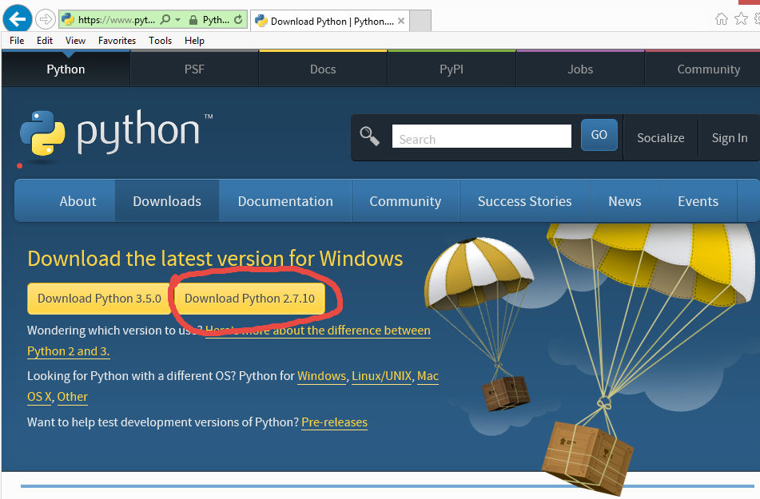
Install Python 2.7.X on Windows 8.1
Screen captures of installing Python and setting PATH variable.

Slide 10
Installing Python2.7.x on Windows 8.1
From https://www.python.org/download/releases/2.7.6 download appropriate Python 2.7.6 Windows Installer.
Run the file
Select install for all users or install just for me, click Next
You'll see it installs under the C:\Python27 folder, click Next
Click Next again for the 'Customize Python' step
Click Finish
Open Control Panel, then System
Click 'Advanced system settings' on the left
Click the 'Environment Variables' button
Under 'System variables' click the variable called 'Path' then the 'Edit...' button. (This will set it for all users, you could instead choose to edit the User variables to just set python as a command prompt command for the current user)
Without deleting any other text, add C:\Python27; (include the semi-colon) to the beginning of the 'Variable value' and click OK.
Click OK on the 'Environment Variables' window.

Slide 11
Components needed npm node-gyp modules at: https://www.npmjs.com/package/node-gyp

Slide 12
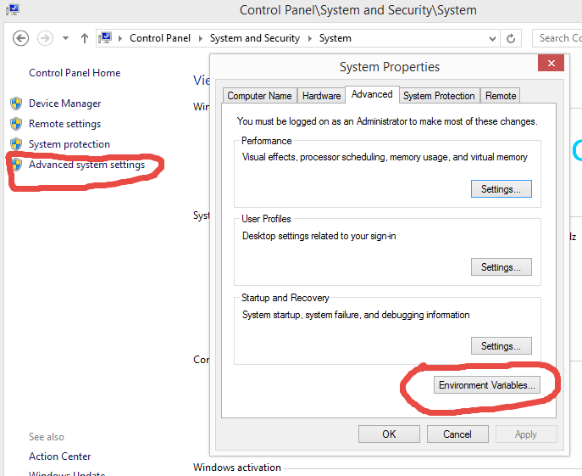
Set paths for Python

Slide 13
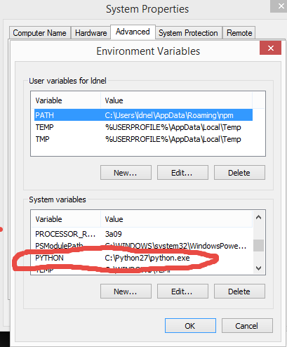
Set paths for Python

Slide 14
Installing npm node-gyp module This is the utility that builds (compiles) native npm modules by invoking the necessary installed compilers. (Make sure to install node-gyp with –g option) npm install –g node-gyp

Slide 15
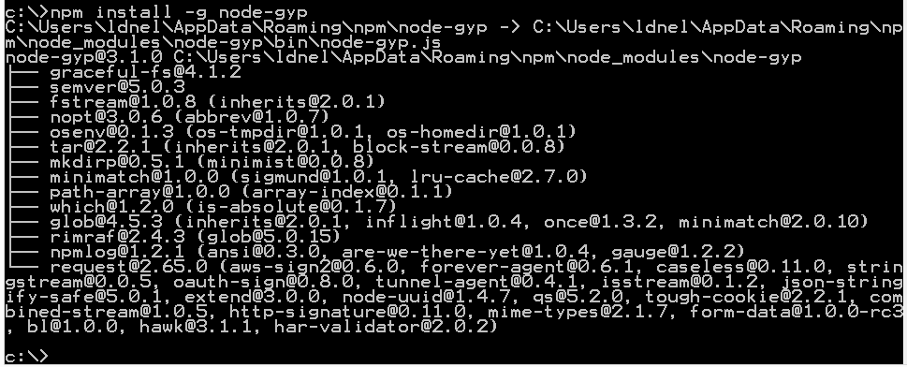
npm install –g node-gyp

Slide 16
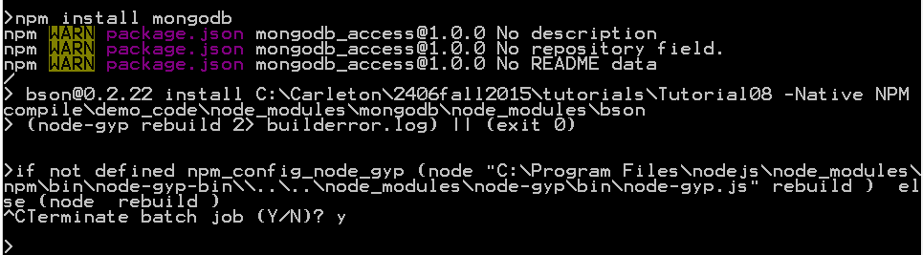
Finally ready to install the npm mongodb driver npm install mongodb
I had to manually terminate the batch job which is probably trying to rebuild node,
However the mongodb driver did install.
After this I was able to do tutorial 08 with the latest npm mongodb driver

Slide 17
If any of you have corrections or other suggestions for setting up a native compile environment for (Windows, Unix, Mac) please email me your procedures or corrections and I can post them for others to benefit from. ldnel@scs.carleton.ca

